Slide 1
Fire Services Assessment Study
Coventry, Rhode Island
Stuart McCutcheon
Presented by

Slide 2

Dynamix Consulting Group
Stuart McCutcheon
MPA, EFO, FIFireE

Slide 3
Presentation Overview
Coventry Current Fire Service Delivery
Options and Station Optimization
Questions and Answers

Slide 4
Current Fire Service Delivery

Slide 5
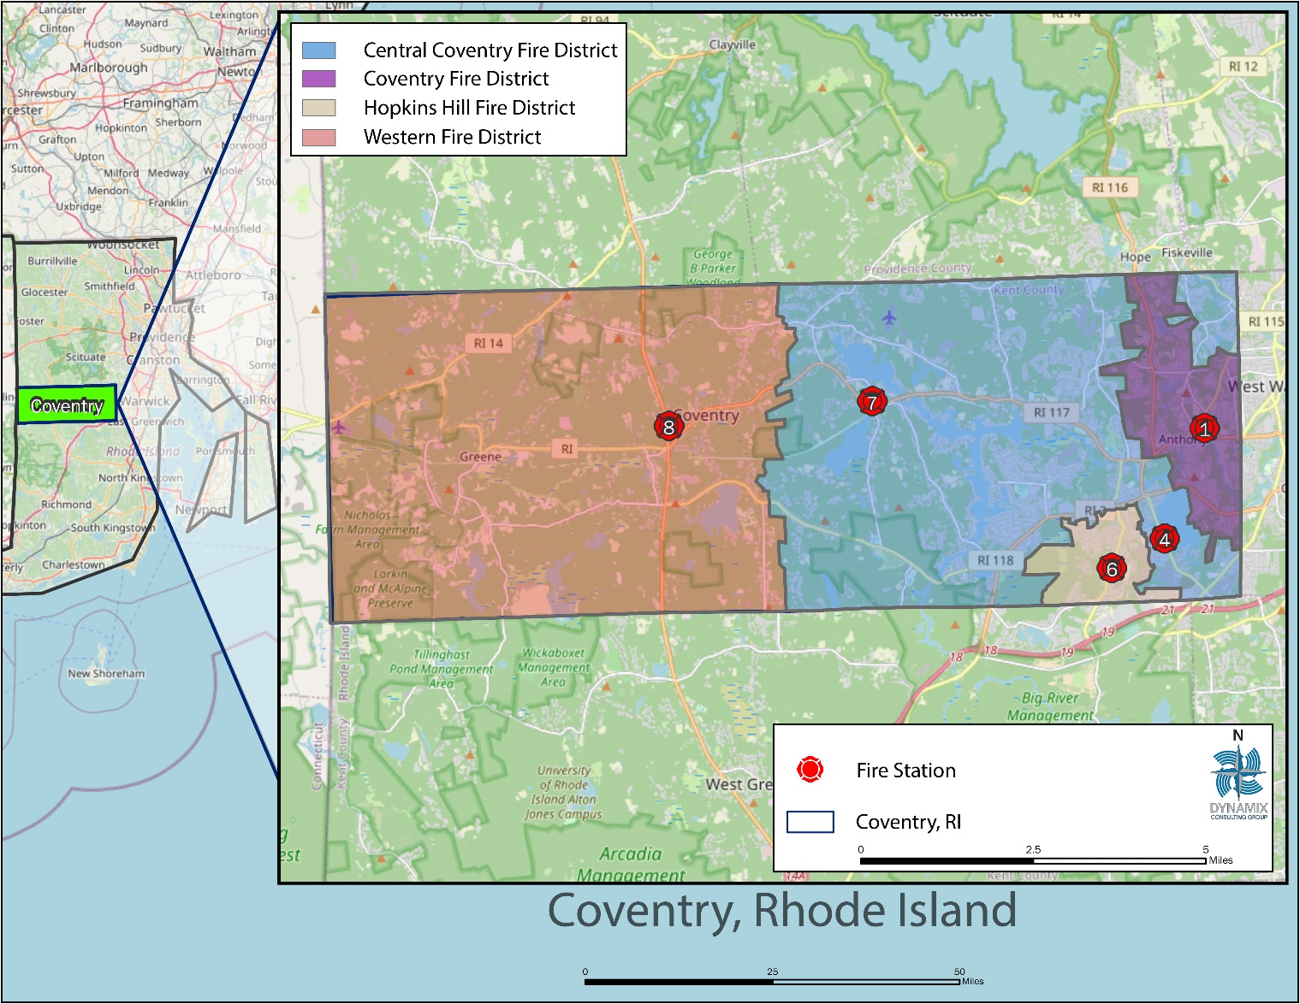
Deployment Overview

Slide 6
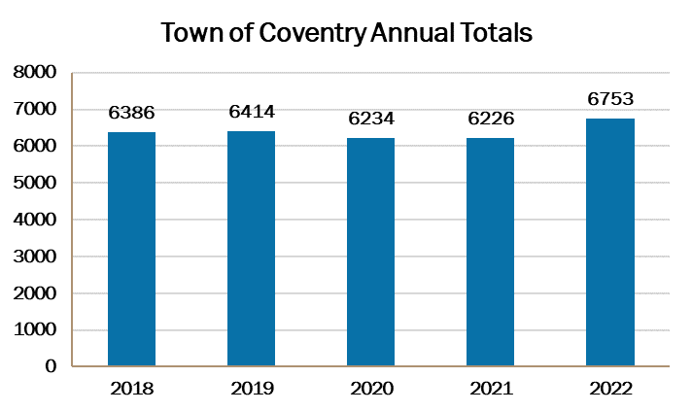
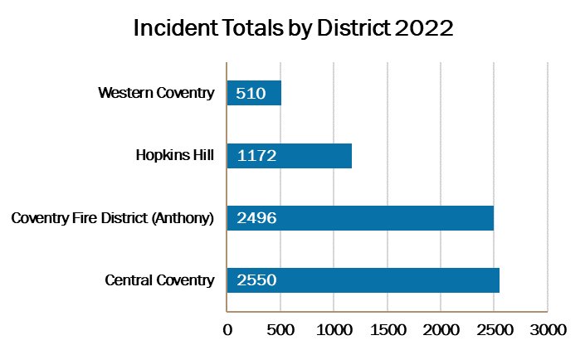
Service Demand

Slide 7
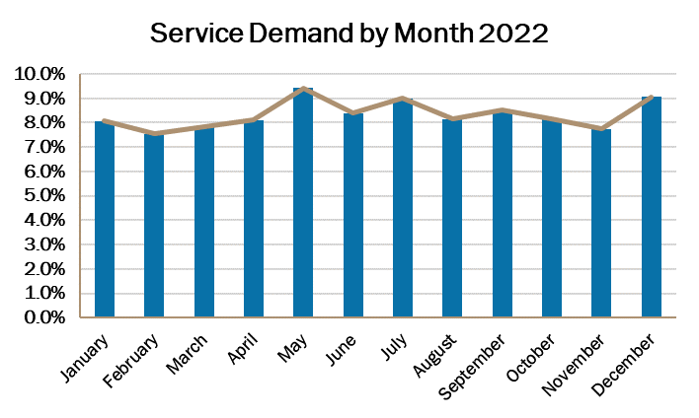
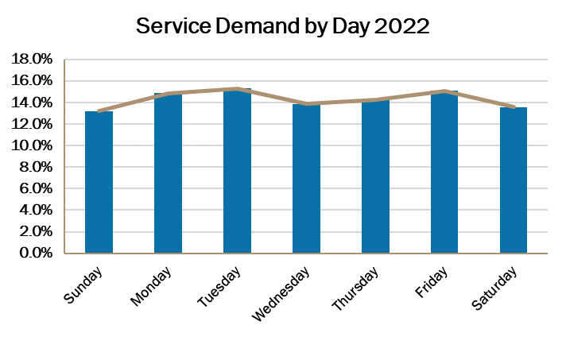
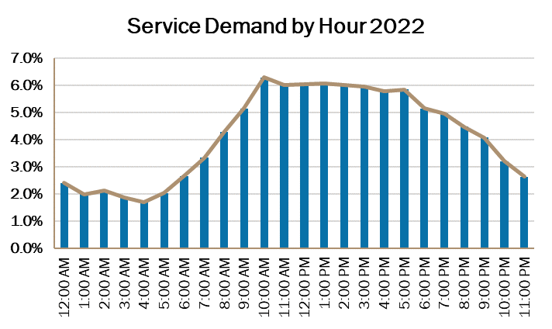
Temporal Variation

Slide 8
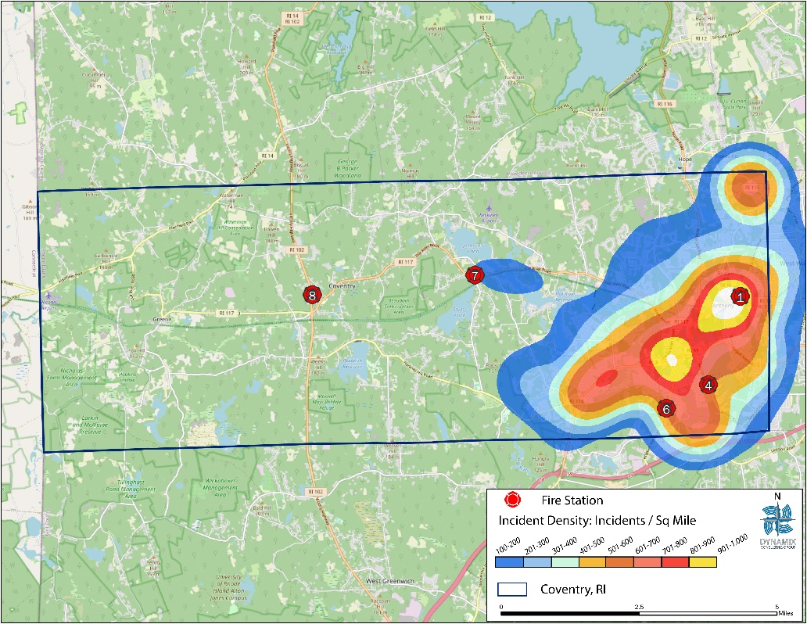
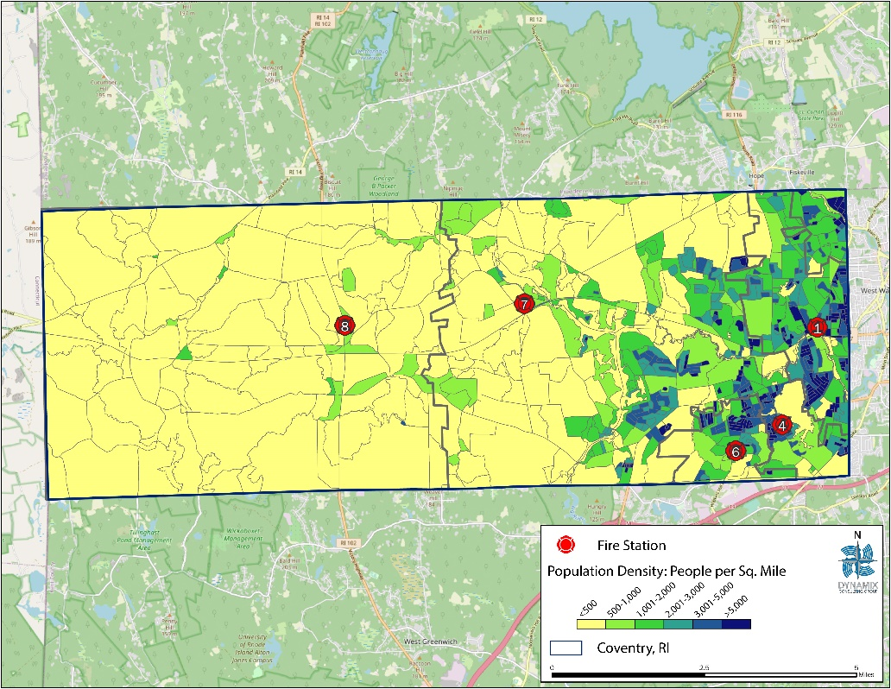
Population Density and Hot Spot Analysis

Slide 9
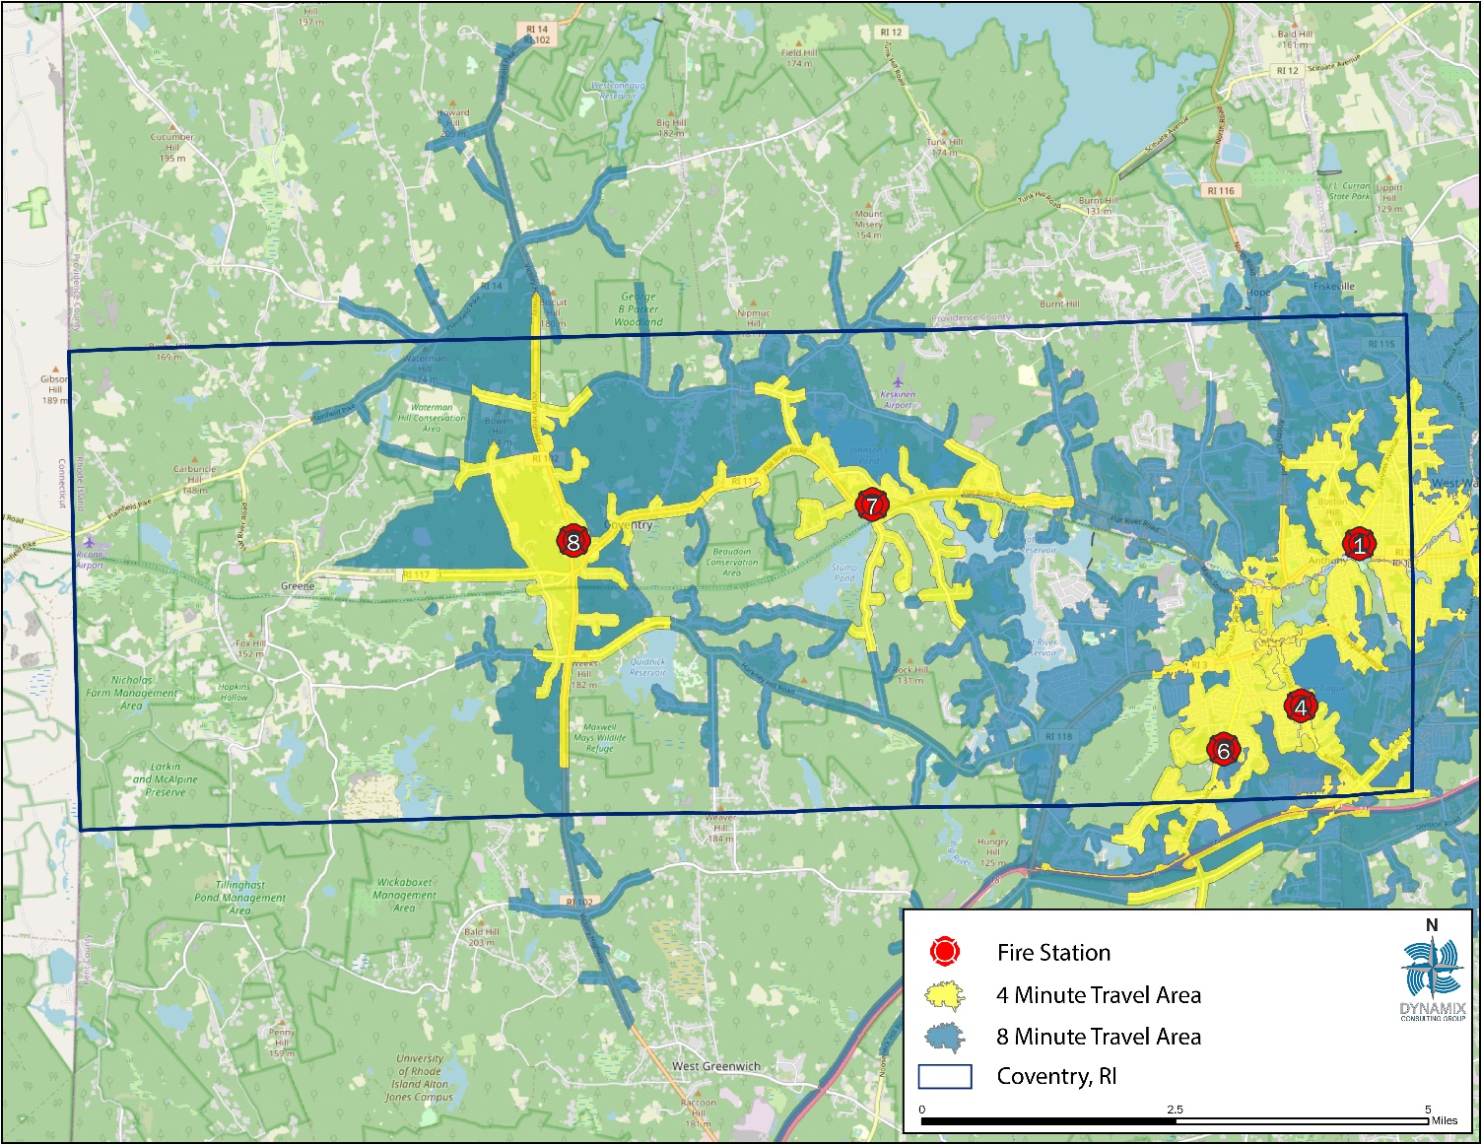
4 and 8-Minute Travel

Slide 10
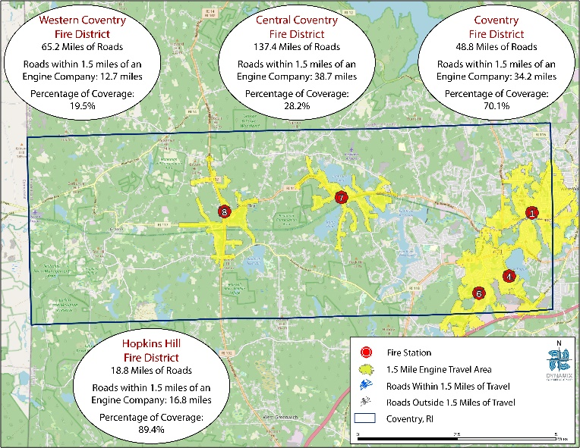
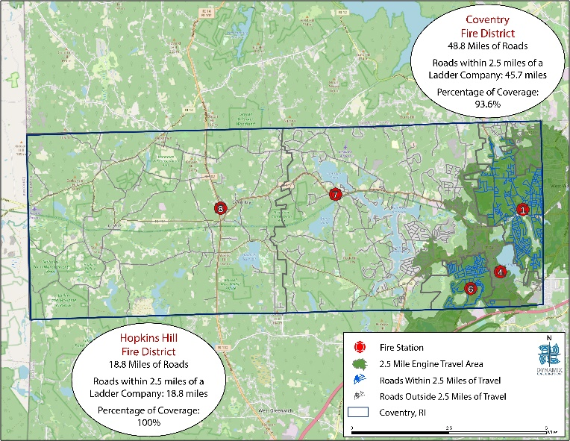
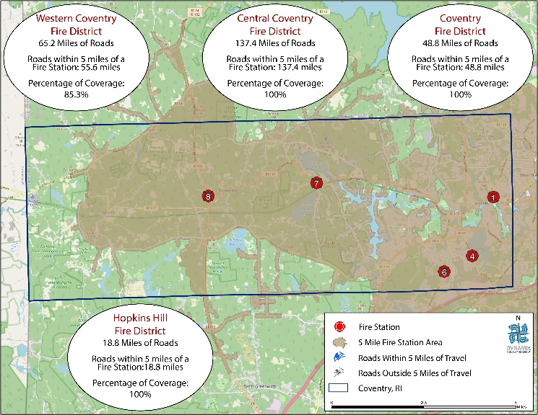
Insurance Services Office

Slide 11
Resource Reliability

Slide 12
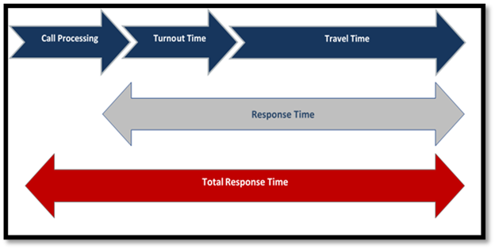
Response Continuum

Slide 13
Call Processing
At the time of this project, the RMS data provided contained no initial call received time information This prevented the calculation of this metric.

Slide 14
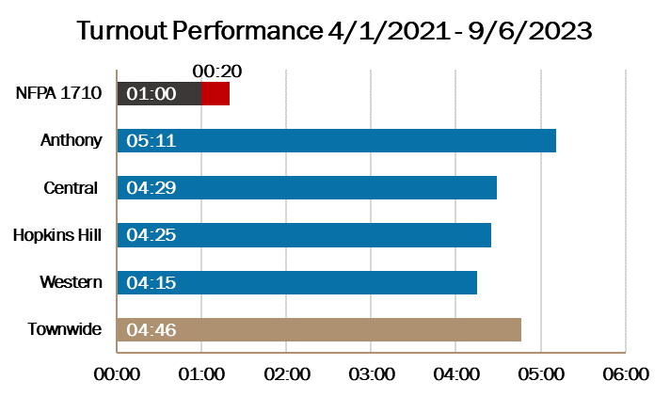
Turnout Time

Slide 15
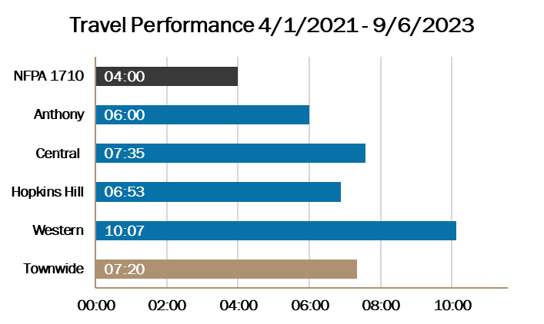
Travel Time

Slide 16
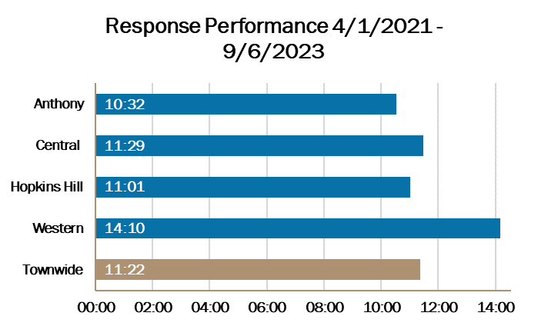
Response Performance

Slide 17
Options for Consideration

Slide 18
Options for Consideration
Option 1: Status Quo Financial Projection of Individual Districts
  This option will likely create a critical situation when one or more of the four independent fire districts are no longer financially sustainable.
  In the short term, the annual budgets will become more volatile, and in the long term, one or more of the fire districts could face the prospect of insolvency if aggressive steps are not taken to stabilize the finances.

Slide 19
Options for Consideration
Option 2: Single Fire District Financial Projection
  This option will likely create a critical situation when one or more of the four independent fire districts are no longer financially sustainable.
  In the short term, the annual budgets will become more volatile, and in the long term, one or more of the fire districts could face the prospect of insolvency if aggressive steps are not taken to stabilize the finances.

Slide 20
Options for Consideration
Option 3: Town Fire Department Financial Projection
  A Town Fire Department provides the Town with direct control over fire/rescue services
  Responsibility for providing this service – and the associated costs - with the Town
  No requirement for a referendum

Slide 21
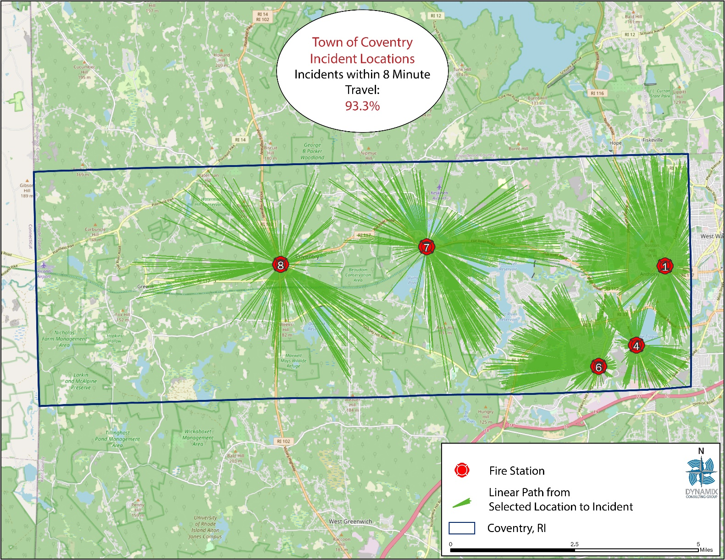
Station Optimization

Slide 22
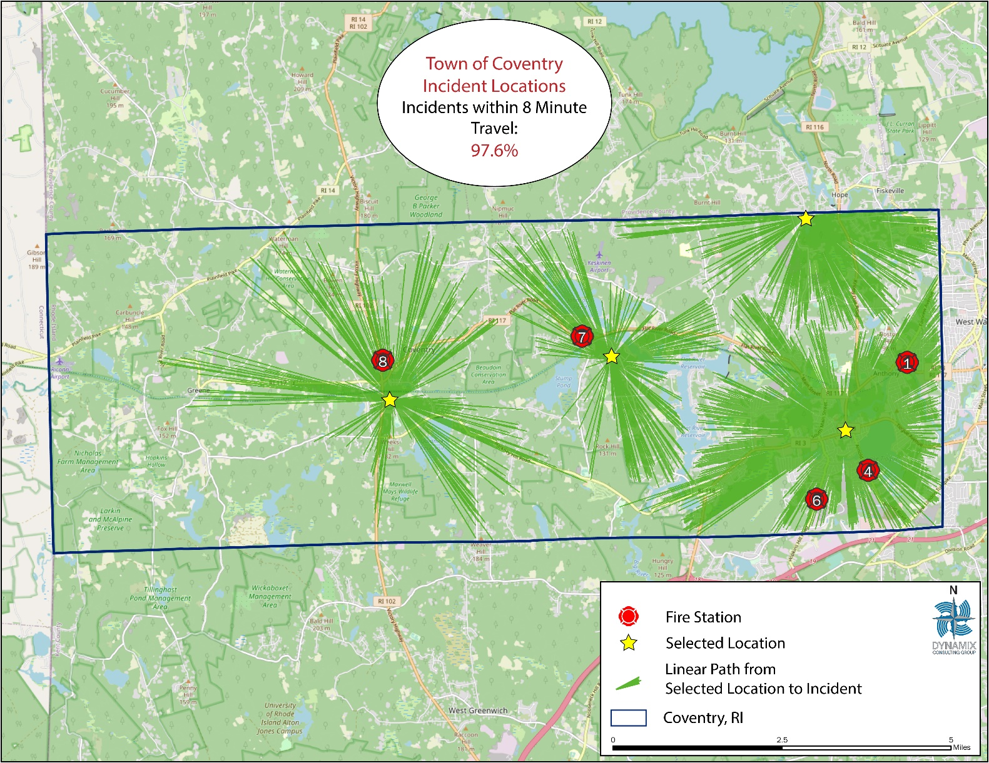
Station Optimization

Slide 23
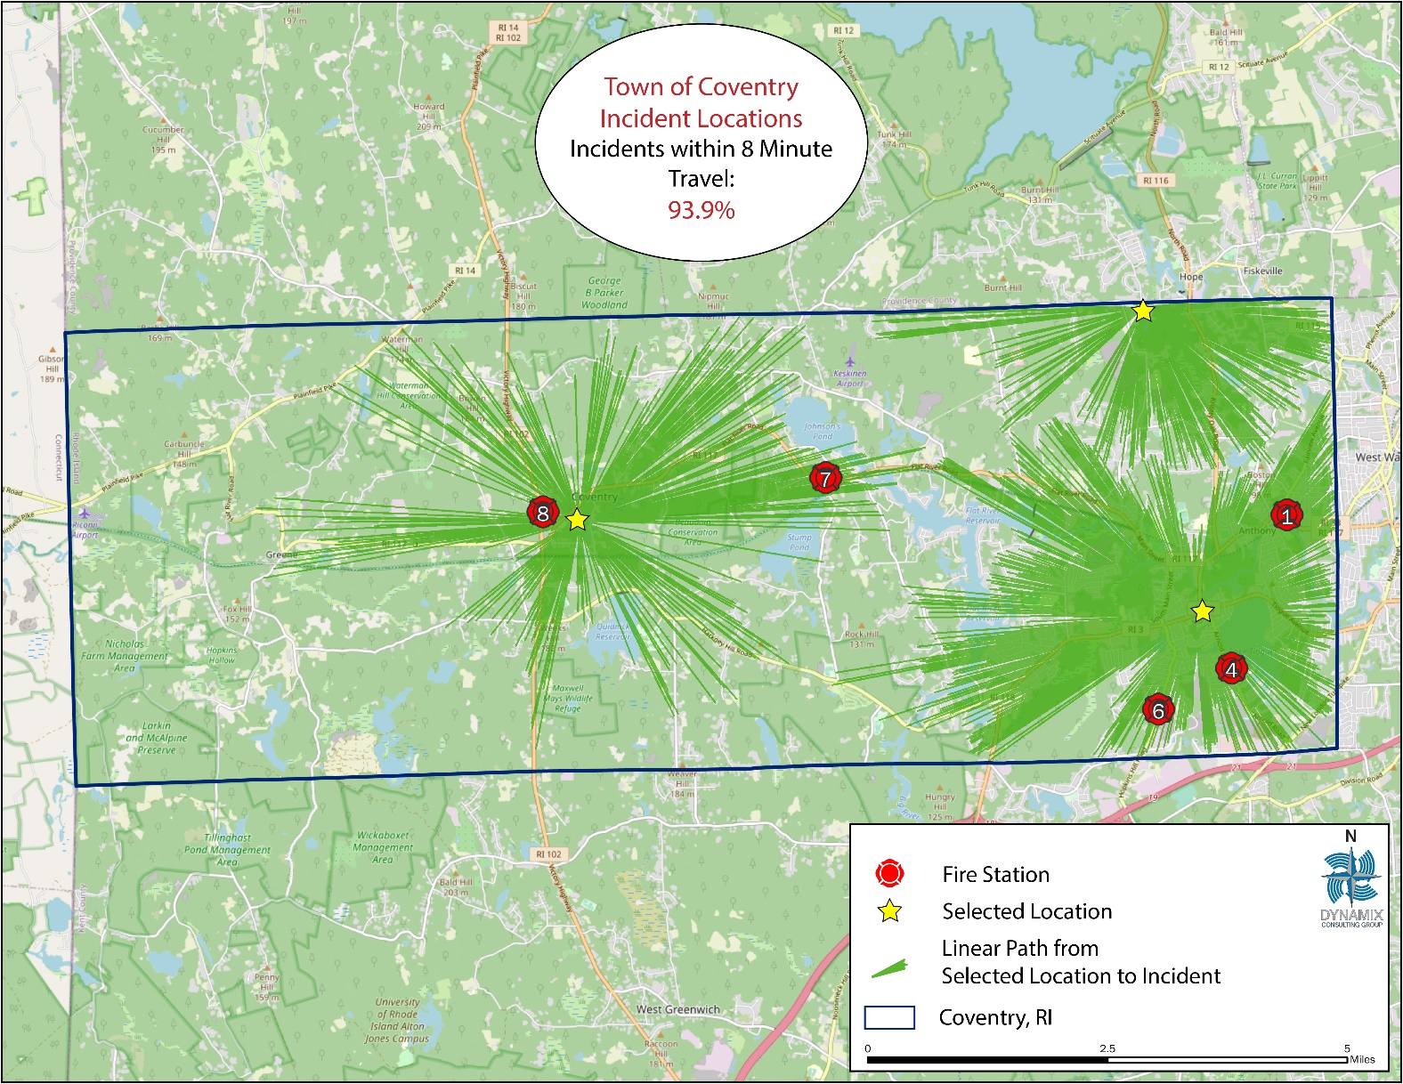
Station Optimization

Slide 24
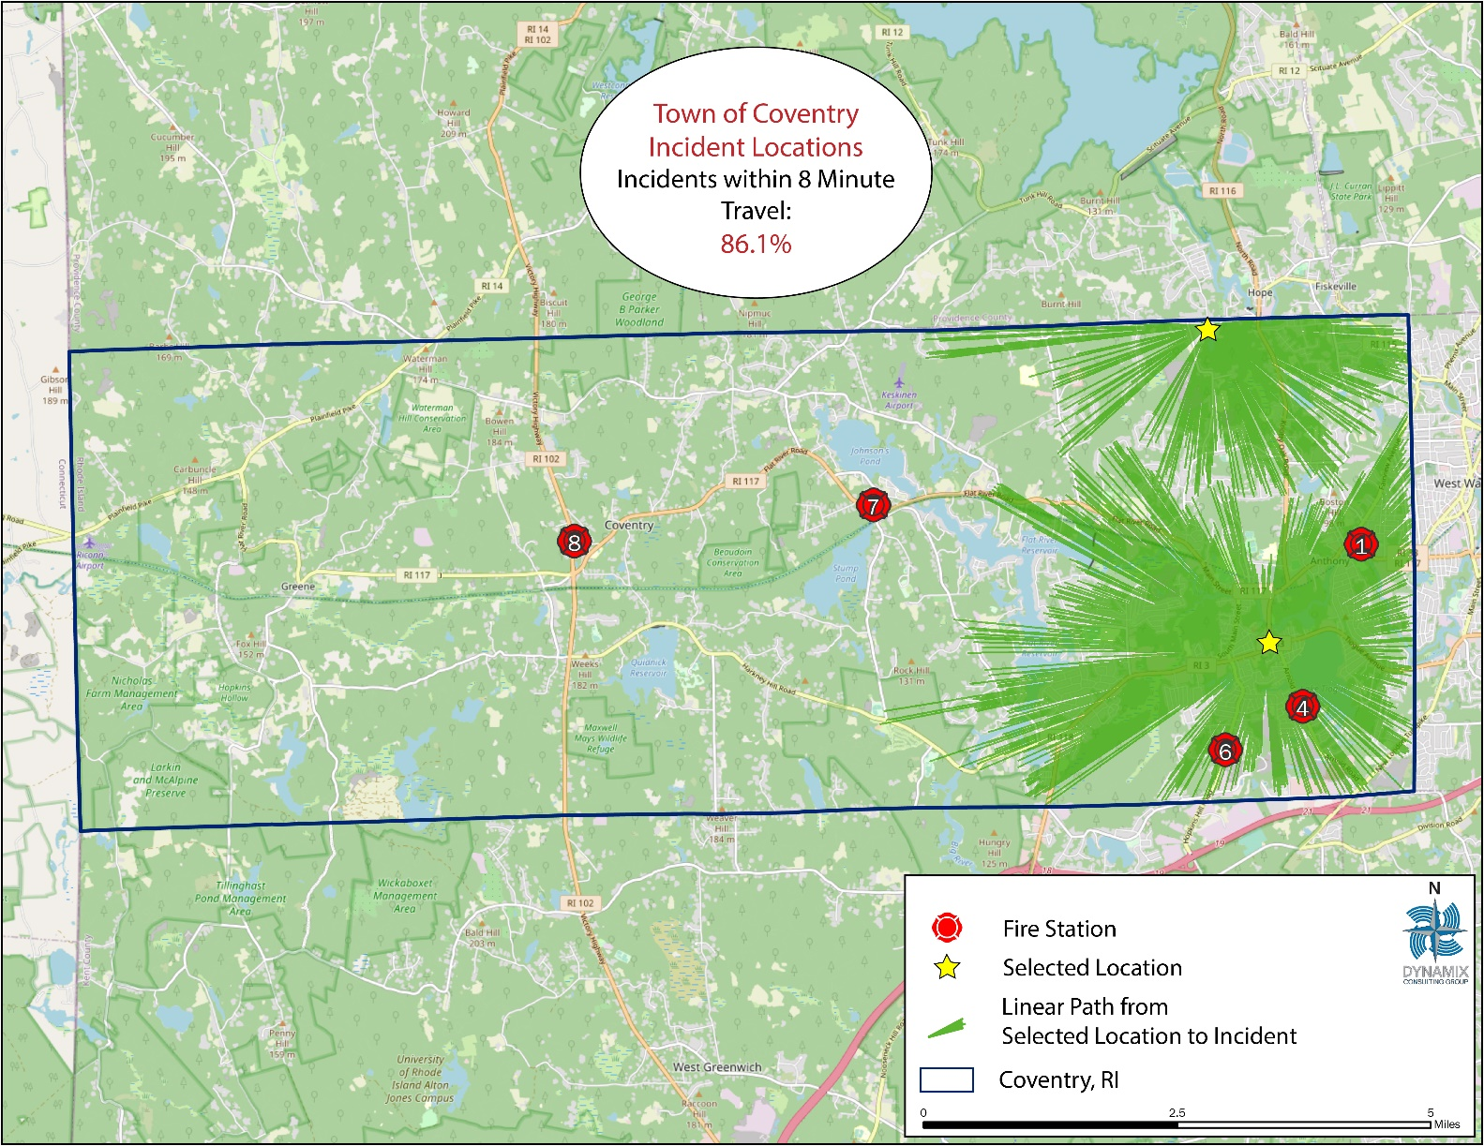
Station Optimization

Slide 25
Questions?

